Slide 1
CSE332 INDUSTRY ETHICS AND LEGAL ISSUES
Hands on tools for
cyber security), case studies on
cyber crimes)

Slide 2
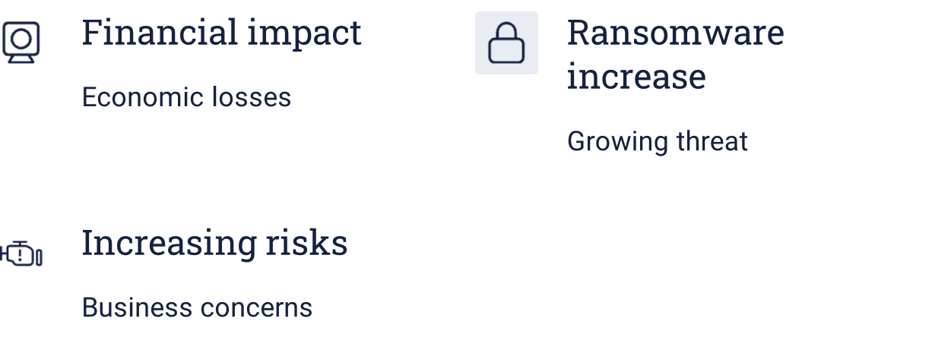
The Growing Importance of Cybersecurity
Cybersecurity is more critical than ever.
By 2025, global damage from cybercrime is expected to reach $10.5 trillion.
Ransomware attacks rose by 13% in 2023.
An estimated 68% of business leaders feel their cybersecurity risks are increasing.
Learn how to stay secure.

Slide 3
Essential Cybersecurity Tools for Protection
Use these essential tools to enhance your cybersecurity:
Firewalls provide a first line of defense.
VPNs protect data in transit by encrypting connections.
Anti-virus software prevents known threats.
Intrusion Detection Systems (IDS) provide real-time threat monitoring.

Slide 4
Cybersecurity Tools
1. Network Security Tools:
- Wireshark, Nmap, Snort, Tcpdump
2. Endpoint Security Tools:
- CrowdStrike Falcon, Symantec, Bitdefender GravityZone
3. Penetration Testing Tools:
- Metasploit, Burp Suite, Nessus, Kali Linux
4. Forensics & Investigation Tools:
- Autopsy, FTK Imager, Volatility
5. SIEM Tools:
- Splunk, IBM QRadar, ELK Stack

Slide 5
Advanced Tools for Proactive Defense
Employ advanced tools for robust defense:
Endpoint Detection and Response (EDR) identifies and responds to endpoint threats.
Vulnerability scanners detect system weak points.
Encryption tools secure sensitive data.
Security Information and Event Management (SIEM) offers holistic monitoring.

Slide 6
Case Study 1: Colonial Pipeline Ransomware Attack (2021)
The Colonial Pipeline attack disrupted the U.S. fuel supply.
Hackers received a $4.4 million Bitcoin payment.
This case highlights the importance of:
Multi-Factor Authentication (MFA)
Network segmentation
Take steps now to ensure you are secure.

Slide 7

Case Study 2: Email Phishing Against a Fortune 500 Company
A phishing attack led to a $100 million loss in wire fraud.
The attack vector involved deceptive emails impersonating executives.
To prevent email scams, implement:
Staff training
SPF, DKIM, and DMARC email authentication protocols

Slide 8
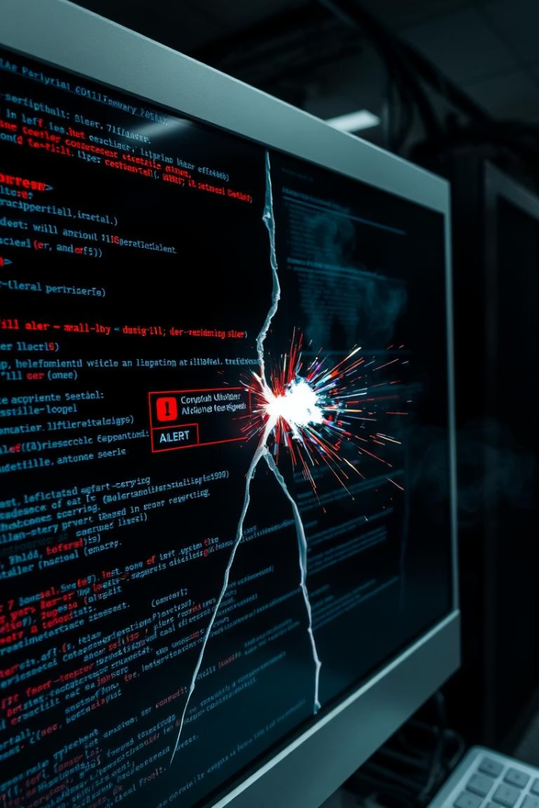
Case Study 3: Data Breach at Equifax (2017)
The Equifax data breach compromised personal data of 147 million people.
Cause: An unpatched vulnerability in Apache Struts software.
This case illustrates the critical need for:
Timely software updates
Effective patch management

Slide 9

Best Practices for Cybersecurity Resilience
Regular software updates and patch management
Implement Multi-Factor Authentication (MFA)
Conduct employee cybersecurity awareness training
Use strong, unique passwords and a password manager
Backup critical data regularly and securely
Utilize firewalls, antivirus, and endpoint protection
Perform regular vulnerability assessments and penetration testing
Enforce least privilege access controls
Deploy network segmentation and monitoring tools
Establish a robust incident response and recovery plan

Slide 10
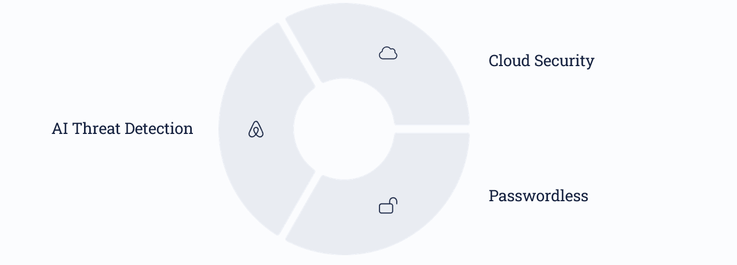
Emerging Trends in Cybersecurity Tools
Stay ahead with emerging tools. AI-powered threat detection offers predictive analytics.
Secure Access Service Edge (SASE) enhances network security.
Password less authentication uses biometrics. Cloud-focused tools protect multi-cloud environments.

Slide 11
Conclusion: Staying Ahead in Cybersecurity
Cybersecurity is continuous, not a one-time fix. Combine tools, processes, and trained people.
Adopt new tools, upgrade existing systems, and educate your team to stay ahead.

